Slide 1
안드로이드 실무 11주차 과제
1901055 정시철

Slide 2
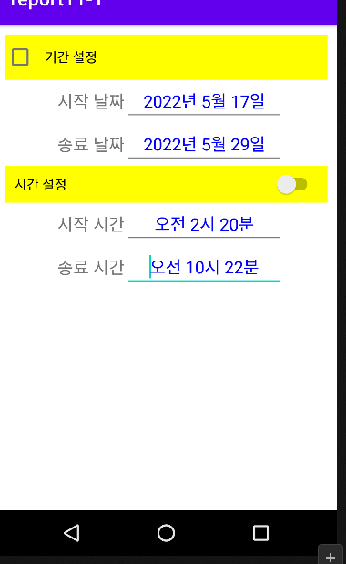
Report 1 기본 Time, DatePickerDialog
<?xml version="1.0" encoding="utf-8"?> <LinearLayout xmlns:android="http://schemas.android.com/apk/res/android" xmlns:tools="http://schemas.android.com/tools" android:layout_width="match_parent" android:layout_height="wrap_content" android:padding="10dp" android:orientation="vertical" tools:context=".MainActivity"> <CheckBox android:id="@+id/checkbox" android:layout_width="match_parent" android:layout_height="wrap_content" android:padding="10dp" android:background="#ffff00" android:text="기간 설정" android:textColor="#000000"/> <LinearLayout android:layout_width="match_parent" android:layout_height="wrap_content" android:gravity="center"> <TextView android:layout_marginLeft="10dp" android:layout_width="wrap_content" android:layout_height="wrap_content" android:text="시작 날짜" android:textAppearance="?android:attr/textAppearanceMedium" /> <EditText android:id="@+id/startDate" android:textColor="#0000ff" android:layout_width="wrap_content" android:layout_height="wrap_content" android:gravity="center" android:ems="8" /> </LinearLayout> <LinearLayout android:layout_width="match_parent" android:layout_height="match_parent" android:gravity="center"> <TextView android:layout_marginLeft="10dp" android:layout_width="wrap_content" android:layout_height="wrap_content" android:text="종료 날짜" android:textAppearance="?android:attr/textAppearanceMedium" /> <EditText android:id="@+id/endDate" android:textColor="#0000FF" android:datePickerMode="spinner" android:layout_width="wrap_content" android:layout_height="wrap_content" android:gravity="center" android:ems="8" /> </LinearLayout> <Switch android:id="@+id/checkbox1" android:layout_width="match_parent" android:layout_height="wrap_content" android:padding="10dp" android:background="#ffff00" android:text="시간 설정" android:textColor="#000000"/> <LinearLayout android:layout_width="match_parent" android:layout_height="wrap_content" android:gravity="center"> <TextView android:layout_marginLeft="10dp" android:layout_width="wrap_content" android:layout_height="wrap_content" android:text="시작 시간" android:textAppearance="?android:attr/textAppearanceMedium" /> <EditText android:id="@+id/startTime" android:textColor="#0000ff" android:layout_width="wrap_content" android:layout_height="wrap_content" android:gravity="center" android:ems="8"/> </LinearLayout> <LinearLayout android:layout_width="match_parent" android:layout_height="match_parent" android:gravity="center"> <TextView android:layout_marginLeft="10dp" android:layout_width="wrap_content" android:layout_height="wrap_content" android:text="종료 시간" android:textAppearance="?android:attr/textAppearanceMedium" /> <EditText android:id="@+id/endTime" android:textColor="#0000FF" android:layout_width="wrap_content" android:layout_height="wrap_content" android:gravity="center" android:ems="8" /> </LinearLayout> </LinearLayout>
package com.example.report11_1; import androidx.appcompat.app.AppCompatActivity; import android.app.DatePickerDialog; import android.app.TimePickerDialog; import android.os.Bundle; import android.view.View; import android.widget.DatePicker; import android.widget.EditText; import android.widget.TimePicker; public class MainActivity extends AppCompatActivity { EditText startDate; EditText endDate; EditText startTime; EditText endTime; @Override protected void onCreate(Bundle savedInstanceState) { super.onCreate(savedInstanceState); setContentView(R.layout.activity_main); startDate = findViewById(R.id.startDate); endDate = findViewById(R.id.endDate); startTime = findViewById(R.id.startTime); endTime = findViewById(R.id.endTime); startDate.setOnClickListener(new View.OnClickListener() { @Override public void onClick(View view) { DatePickerDialog.OnDateSetListener listener = new DatePickerDialog.OnDateSetListener() { @Override public void onDateSet(DatePicker view, int year, int monthOfYear, int dayOfMonth) { startDate.setText(year + "년 " + monthOfYear + "월 " + dayOfMonth +"일"); }}; DatePickerDialog dialog = new DatePickerDialog(MainActivity.this, android.R.style.Theme_Holo_Light_Dialog_NoActionBar, listener, 2022, 5, 29); dialog.getWindow().setBackgroundDrawableResource(android.R.color.transparent); dialog.show(); }}); endDate.setOnClickListener(new View.OnClickListener() { @Override public void onClick(View view) { DatePickerDialog.OnDateSetListener listener = new DatePickerDialog.OnDateSetListener() { @Override public void onDateSet(DatePicker view, int year, int monthOfYear, int dayOfMonth) { endDate.setText(year + "년 " + monthOfYear + "월 " + dayOfMonth +"일"); }}; DatePickerDialog dialog = new DatePickerDialog(MainActivity.this, listener, 2022, 5, 29); dialog.show(); }}); startTime.setOnClickListener(new View.OnClickListener() { @Override public void onClick(View view) { TimePickerDialog.OnTimeSetListener listener = new TimePickerDialog.OnTimeSetListener() { @Override public void onTimeSet(TimePicker timePicker, int i, int i1) { String ampm; if (i > 13) { ampm = "오후 ";i = i - 12; } else ampm = "오전 "; startTime.setText(ampm+i + "시 " + i1 + "분"); }}; TimePickerDialog dialog = new TimePickerDialog(MainActivity.this, android.R.style.Theme_Holo_Light_Dialog_NoActionBar,listener, 10,22,true); dialog.getWindow().setBackgroundDrawableResource(android.R.color.transparent); dialog.show(); }}); endTime.setOnClickListener(new View.OnClickListener() { @Override public void onClick(View view) { TimePickerDialog.OnTimeSetListener listener = new TimePickerDialog.OnTimeSetListener() { @Override public void onTimeSet(TimePicker timePicker, int i, int i1) { String ampm; if (i > 13) { ampm = "오후 ";i = i - 12; } else ampm = "오전 "; endTime.setText(ampm+i + "시 " + i1 + "분"); }}; TimePickerDialog dialog = new TimePickerDialog(MainActivity.this, listener, 10,22,true); dialog.show(); }}); }}
안드로이드 스튜디오 자체에 오류가 있는 것 같습니다.
Spinner을 Java 코드로 아무리 수정해도 안 바뀌길래
레이아웃에서 직접 바로 Calender을 Spinner으로 변경해도
전혀 바뀌지 않아서 그냥 코드상에 문제는 없다고 판단하고 올렸습니다.

Slide 3
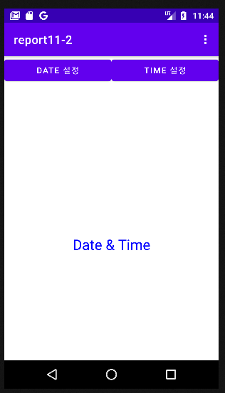
Report 2 기본 Time, DatePickerDialog,메뉴
package com.example.report11_2; import androidx.annotation.NonNull; import androidx.appcompat.app.AppCompatActivity; import android.app.DatePickerDialog; import android.app.TimePickerDialog; import android.os.Bundle; import android.view.Menu; import android.view.MenuInflater; import android.view.MenuItem; import android.view.View; import android.widget.Button; import android.widget.DatePicker; import android.widget.TimePicker; public class MainActivity extends AppCompatActivity { Button date;Button time; boolean sp=false; @Override public boolean onCreateOptionsMenu(Menu menu) { MenuInflater inflater = getMenuInflater(); inflater.inflate(R.menu.men, menu); return super.onCreateOptionsMenu(menu); } @Override public boolean onOptionsItemSelected(@NonNull MenuItem item) { int id = item.getItemId(); if (id == R.id.checkable&&item.isChecked()==false){ item.setChecked(true);sp = true; }else{ item.setChecked(false);sp = false; } return super.onOptionsItemSelected(item); } @Override protected void onCreate(Bundle savedInstanceState) { super.onCreate(savedInstanceState); setContentView(R.layout.activity_main); date = findViewById(R.id.dateButton);time = findViewById(R.id.timeButton); if (sp == true){date.setOnClickListener(new View.OnClickListener() { @Override public void onClick(View view) { DatePickerDialog.OnDateSetListener listener = new DatePickerDialog.OnDateSetListener() { @Override public void onDateSet(DatePicker view, int year, int monthOfYear, int dayOfMonth) {}}; DatePickerDialog dialog = new DatePickerDialog(MainActivity.this, listener, 2022, 5, 29); dialog.show(); }}); time.setOnClickListener(new View.OnClickListener() { @Override public void onClick(View view) { TimePickerDialog.OnTimeSetListener listener = new TimePickerDialog.OnTimeSetListener() { @Override public void onTimeSet(TimePicker timePicker, int i, int i1) {}}; TimePickerDialog dialog = new TimePickerDialog(MainActivity.this, listener, 10,22,true); dialog.show(); }}); } else{ date.setOnClickListener(new View.OnClickListener() { @Override public void onClick(View view) { DatePickerDialog.OnDateSetListener listener = new DatePickerDialog.OnDateSetListener() { @Override public void onDateSet(DatePicker view, int year, int monthOfYear, int dayOfMonth) {}}; DatePickerDialog dialog = new DatePickerDialog(MainActivity.this, android.R.style.Theme_Holo_Light_Dialog_NoActionBar, listener, 2022, 5, 29); dialog.getWindow().setBackgroundDrawableResource(android.R.color.transparent); dialog.setTitle("시간을 선택해주세요."); dialog.show(); }}); time.setOnClickListener(new View.OnClickListener() { @Override public void onClick(View view) { TimePickerDialog.OnTimeSetListener listener = new TimePickerDialog.OnTimeSetListener() { @Override public void onTimeSet(TimePicker timePicker, int i, int i1) {}}; TimePickerDialog dialog = new TimePickerDialog(MainActivity.this, android.R.style.Theme_Holo_Light_Dialog_NoActionBar,listener, 10,22,true); dialog.getWindow().setBackgroundDrawableResource(android.R.color.transparent); dialog.setTitle("시간을 선택해주세요."); dialog.show(); }}); } }}
1번과 같은 오류가 있습니다.
<?xml version="1.0" encoding="utf-8"?> <LinearLayout xmlns:android="http://schemas.android.com/apk/res/android" xmlns:tools="http://schemas.android.com/tools" android:layout_width="match_parent" android:layout_height="match_parent" android:orientation="vertical" tools:context=".MainActivity"> <LinearLayout android:orientation="horizontal" android:layout_width="match_parent" android:layout_height="wrap_content"> <Button android:id="@+id/dateButton" android:layout_width="0dp" android:layout_height="wrap_content" android:text="Date 설정" android:layout_weight="1" /> <Button android:id="@+id/timeButton" android:layout_width="0dp" android:layout_height="wrap_content" android:text="Time 설정" android:layout_weight="1" /> </LinearLayout> <TextView android:id="@+id/date" android:layout_marginTop="20dp" android:textSize="20dp" android:layout_width="wrap_content" android:layout_height="wrap_content"/> <TextView android:id="@+id/time" android:textSize="20dp" android:layout_width="wrap_content" android:layout_height="wrap_content"/> <TextView android:id="@+id/dateTimeTextView" android:textSize="24dp" android:gravity="center" android:layout_width="match_parent" android:layout_height="match_parent" android:textColor="#0000FF" android:text="Date &amp; Time"/> </LinearLayout>

Slide 4
Time, DatePickerDialog에서 모드를 스피너로 변경할때 변경 했음에도 적용되지 않는 버그가 있어서 건너뛰었습니다. 양해 바랍니다.

